Slide 1




Coupling water, fire and climate resilience with biomass production from forestry to adapt watersheds to climate change
Rosewood Final Conference
Florence, 15 January 2020
Maurizio Cocchi
The project LIFE RESILIENT FORESTS – Coupling water, fire and climate resilience with biomass production from forestry to adapt watersheds to climate change is co-funded by the LIFE Programme of the European Union under contract number LIFE 17 CCA/ES/000063.

Slide 2



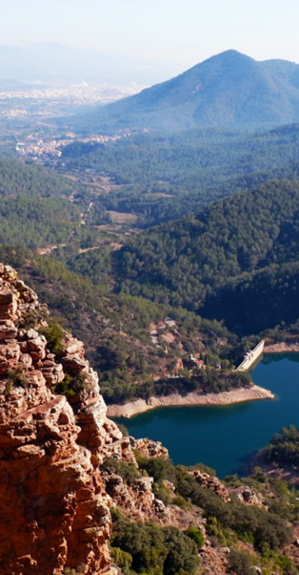
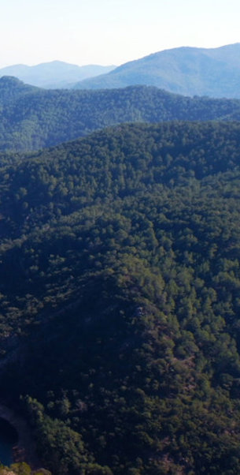
Aim: Promote a forest management approach at the watershed scale that improves forests resilience to wildfires, water scarcity, environmental degradation and other effects induced by climate change.
Start: November 2018
Duration: 4 years
Co-funded by the EU LIFE Programme

Slide 3





PARTNERS
FORSCHUNGSZENTRUM JÜLICH GMBH Germany
ASSOCIAÇÃO PARA O DESENVOLVIMENTO DA AERODINÂMICA INDUSTRIAL
Portugal
RESEARCH INSTITUTE OF WATER AND ENVIRONMENTAL ENGINEERING Technical University of Valencia, Spain
EUROPEAN BIOMASS INDUSTRY ASSOCIATION Belgium
AYUNTAMIENTO DE SERRA Spain

Slide 4
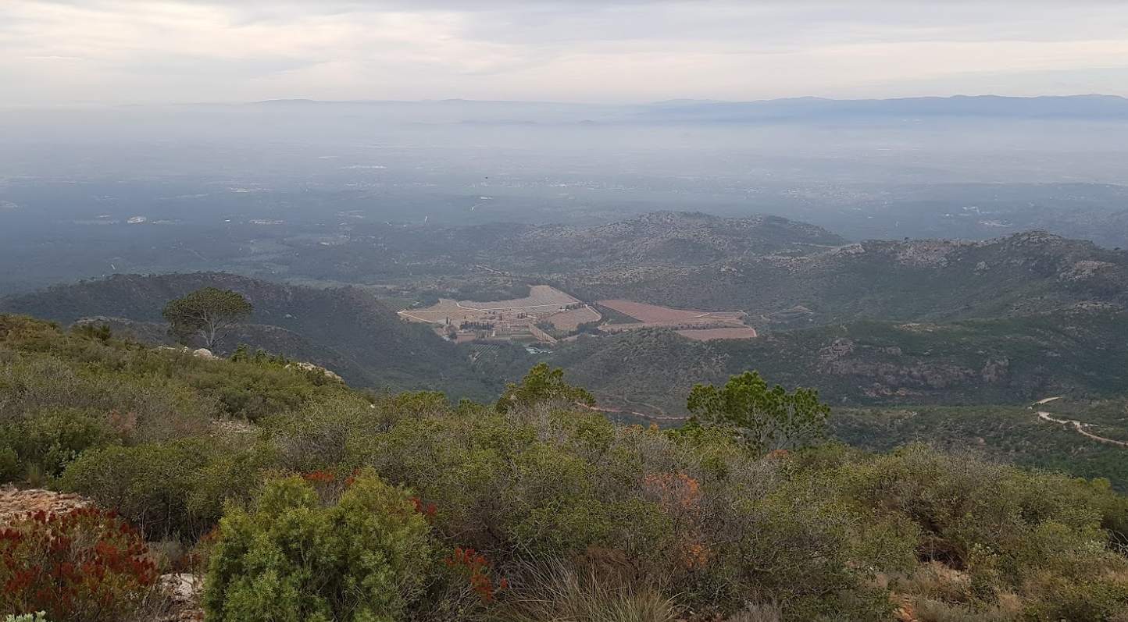
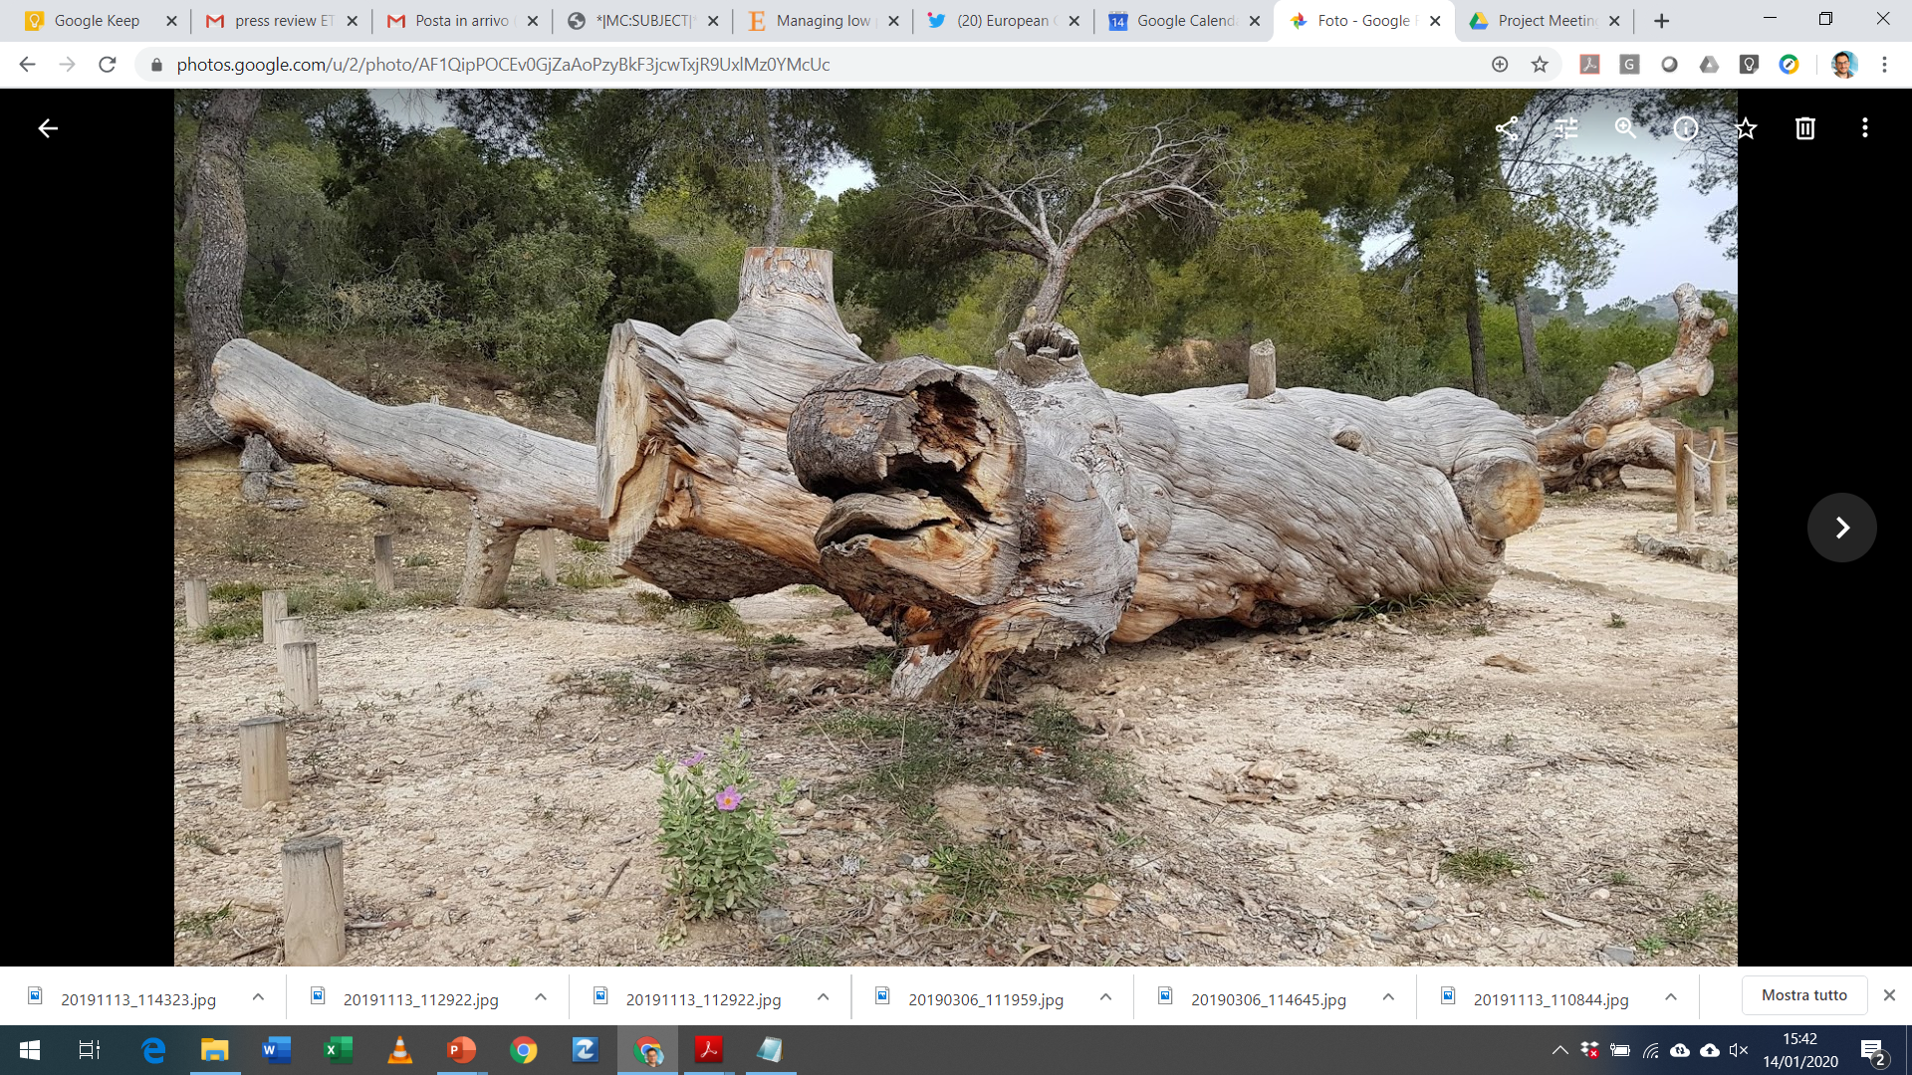
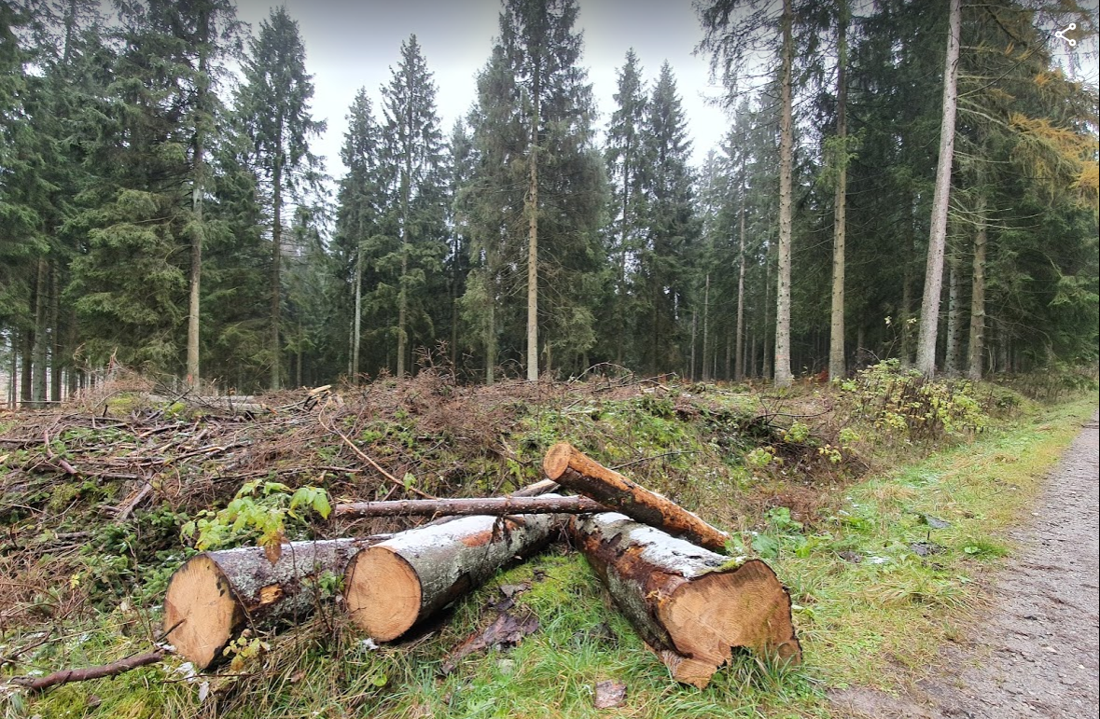
Climate change affects forests ecosystems
The effects of climate change on forest ecosystems are evident across the world.
Climate change affects forest ecosystems negatively by making forests less resilient to disturbances
reduced plant growth
increased frequency and intensity of pest and disease outbreaks
wildfires and wind storms
Estimated 35 million m3 wood damaged annually by disturbances such as storms and wildfires in Europe
During the last 30 years, the EU area affected by water scarcity and droughts increased from 6 to 13%

Slide 5
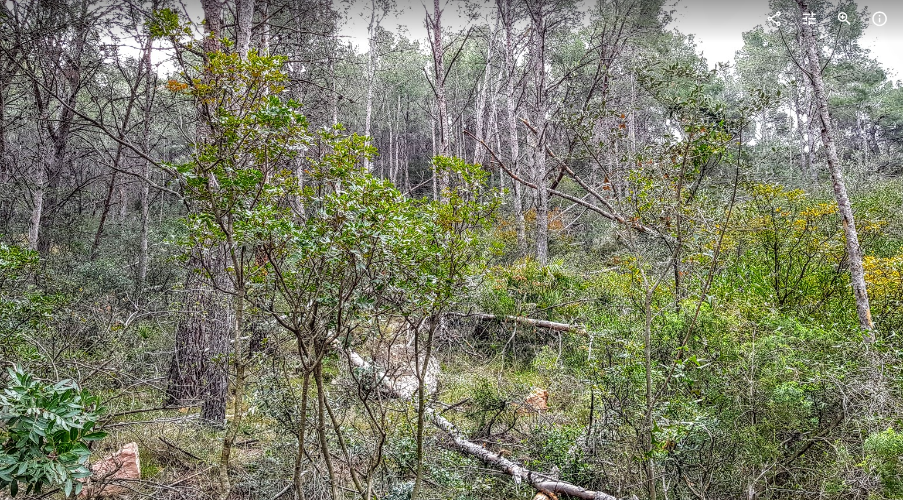
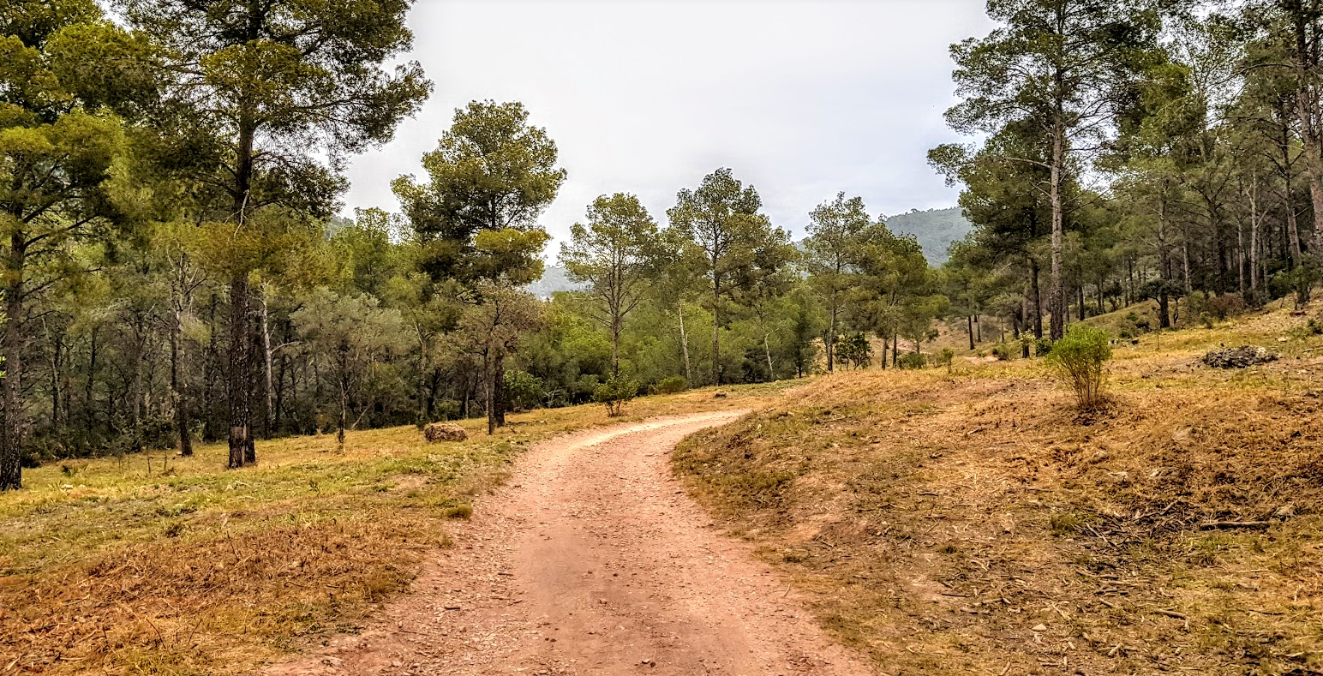
Forest management as a strategy to adapt forest ecosystems to climate change
Besides enhancing the productive functions of forests, forest management can also contribute to:
reducing fire risk
Increasing water yield
increasing ecosystem resilience
improving tree growth and vigor
enhancing landscape value
This approach could be easily applied into productive areas, where the marketable forest products might result profitable enough to cope with the management costs, and the rests of the benefits can just be considered as additional.

Slide 6
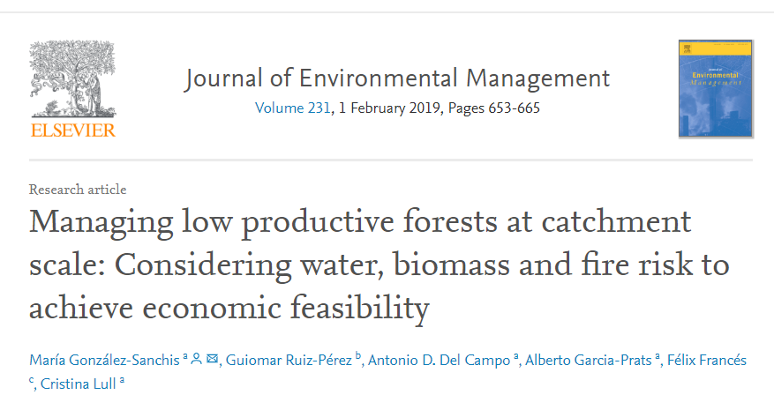
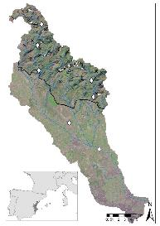
Integrated approach to water fire and biomass
Traditional forest management of semi-arid forests non-profitable
Forest management for water yield increases water availability , but not enough to be viable
Including biomass and fire risk and propagation reduction increases benefit/cost ratio
The management should be multicriteria and at catchment scale to maximize the benefits
Source:www.sciencedirect.com/science/article/pii/S0301479718312131

Slide 7
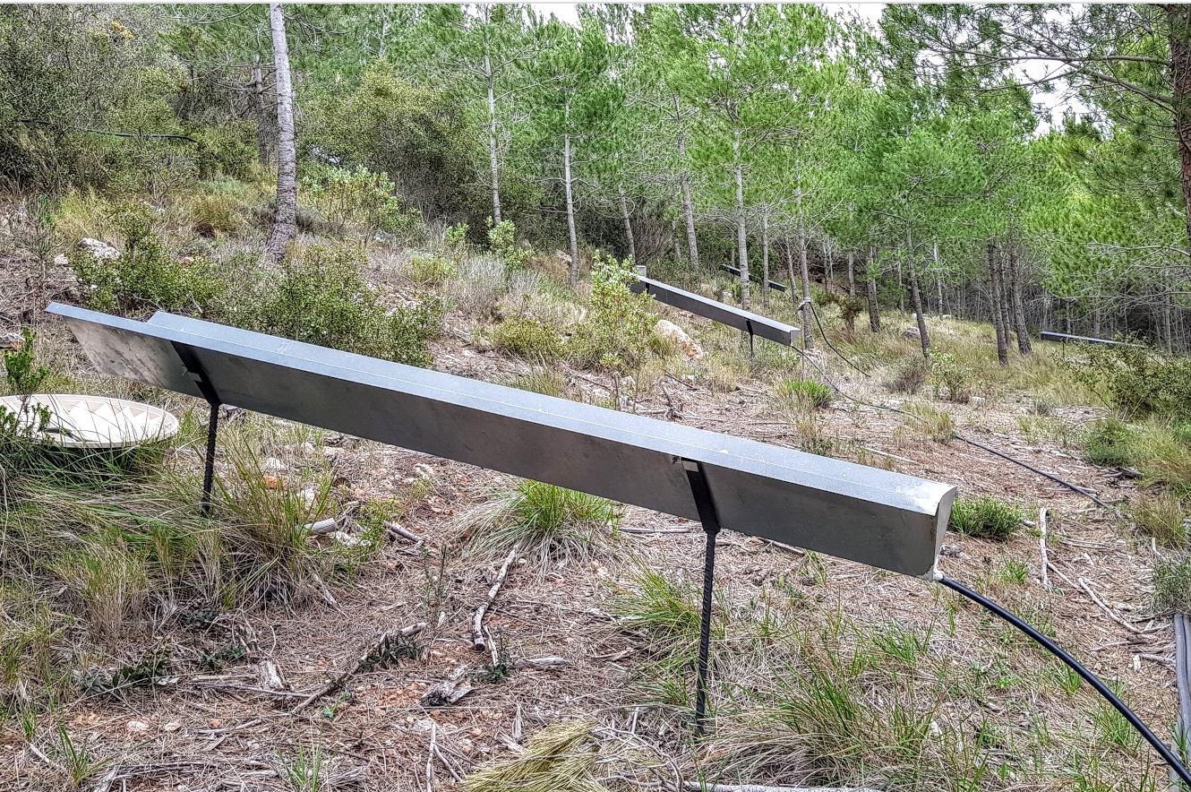
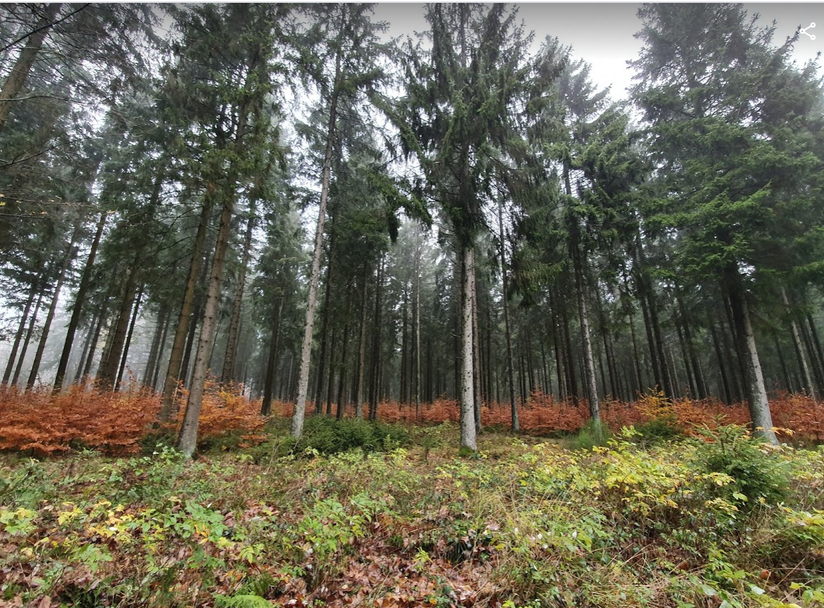
Three study sites
Spain
Carraixet catchment in Natural Park La Sierra Calderona (Valencia)
Aleppo pine post-fire regeneration stands monitored for water yield, fire risk, and biomass production
Germany
Wüstebach catchment in Eifel National Park NW Germany
Norway Spruce and Beech
Hydrology , part of Tereno network of terrestrial observatories and study on ecosystem effects of deforestation
Portugal
Basin of Arouce river
Oak, laurel, willow
Fire risk studies
Notes:
The economic quantification showed the managed scenario as profitable, just considering the water contribution. However, this efficiency in monetary terms is still lower than the current situation, where no management costs are considered. When fire propagation is included, the results are overturned, and forest management becomes more efficient by avoiding fire extinction and restoration costs. These results reveal the difficulties of semi-arid forests to be managed. In other words, this optimal management should be approached from a multi-purpose perspective that maximizes all the potentials profitability of the forest ecosystem services, which individually cannot be enough efficient from an economical point of view.

Slide 8
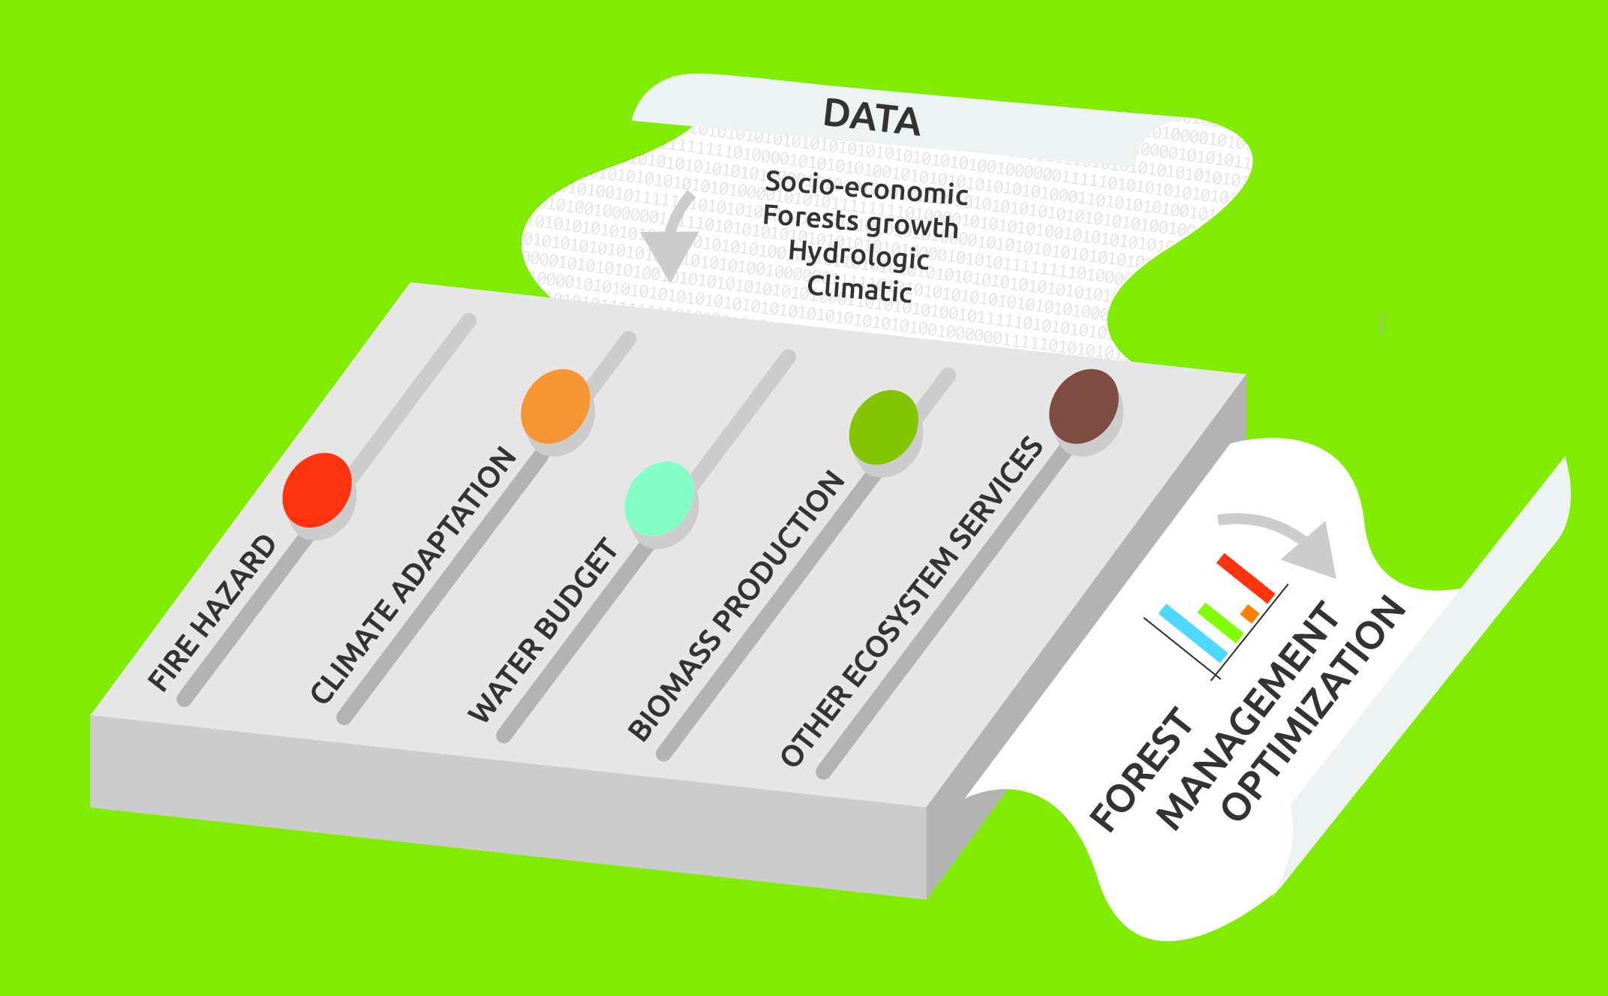
A Decision Support Tool for forest managers
RESILIENT FORESTS is developing a DSS tool to optimize forest management according to the basin hydro-ecological, social and economical needs
  guide forest managers in choosing the right strategy for specific conditions
  optimize and update forest management at the watershed scale incorporating climate change issues.
  combine the main forest goods and forest services into a multi-stakeholder multi-criteria tool based on the different environmental and socioeconomic situations.
  couple the different results of hydrological, biomass, economic and climate change models in order to set optimal management practices.

Slide 9
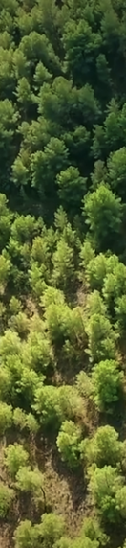

Project Actions
Decision Support System – DSS
LIFE Resilient Forest will develop a system to introduce climate change adaptation strategies in forest management across Europe.
Demonstration
The support system will be adapted to different conditions and demonstrated at three locations in Germany, Portugal and Spain, both at sub-catchment and at catchment scale.
Replication
A replication strategy will be developed for transferring this approach, so it can be applied elsewhere across Europe.
Monitoring
The project will conduct a complete monitoring of the impacts, including a Life Cycle Assessment (LCA) of the system.
Networking
Networking activities with other initiatives related to forest management and climate change, and to facilitate the transfer of information

Slide 10
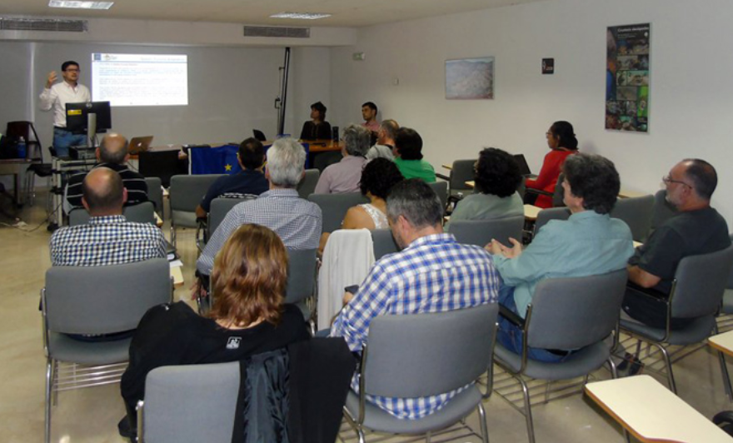
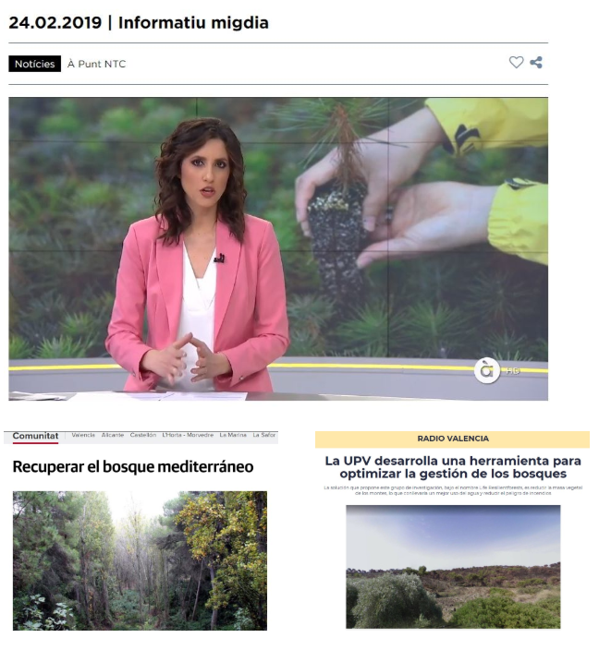
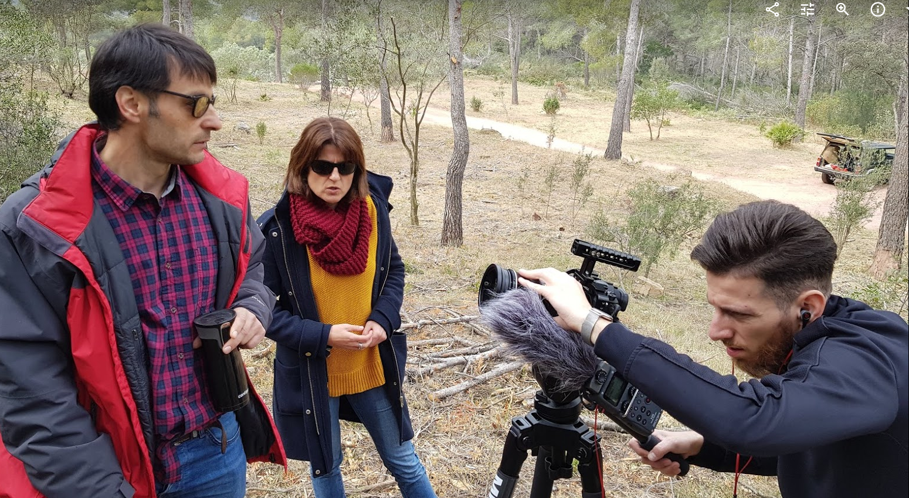
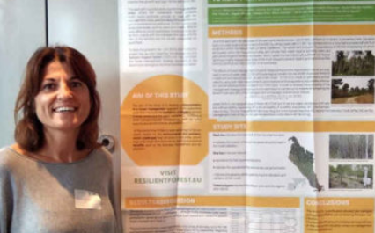
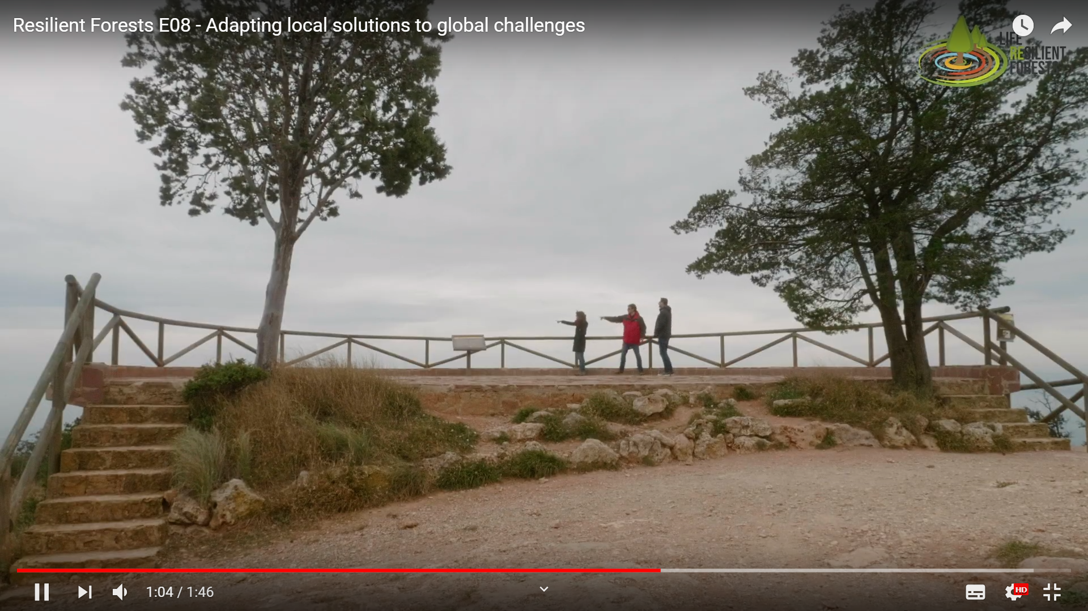
RECENT ACTIVITIES
Workshops
Media coverage
Web series

Slide 11



The project LIFE RESILIENT FORESTS is co-funded by the LIFE Programme of the European Union under contract number LIFE 17 CCA/ES/000063.
Thank you for your attention
www.resilientforests.eu
www.resilientforests.eu
info@resilientforests.eu
@LIFE_RESILIENT
Resilient Forests

