Slide 1



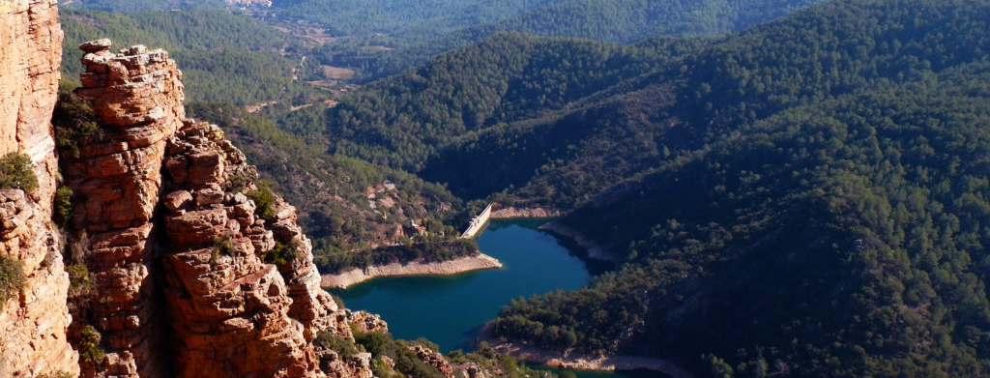

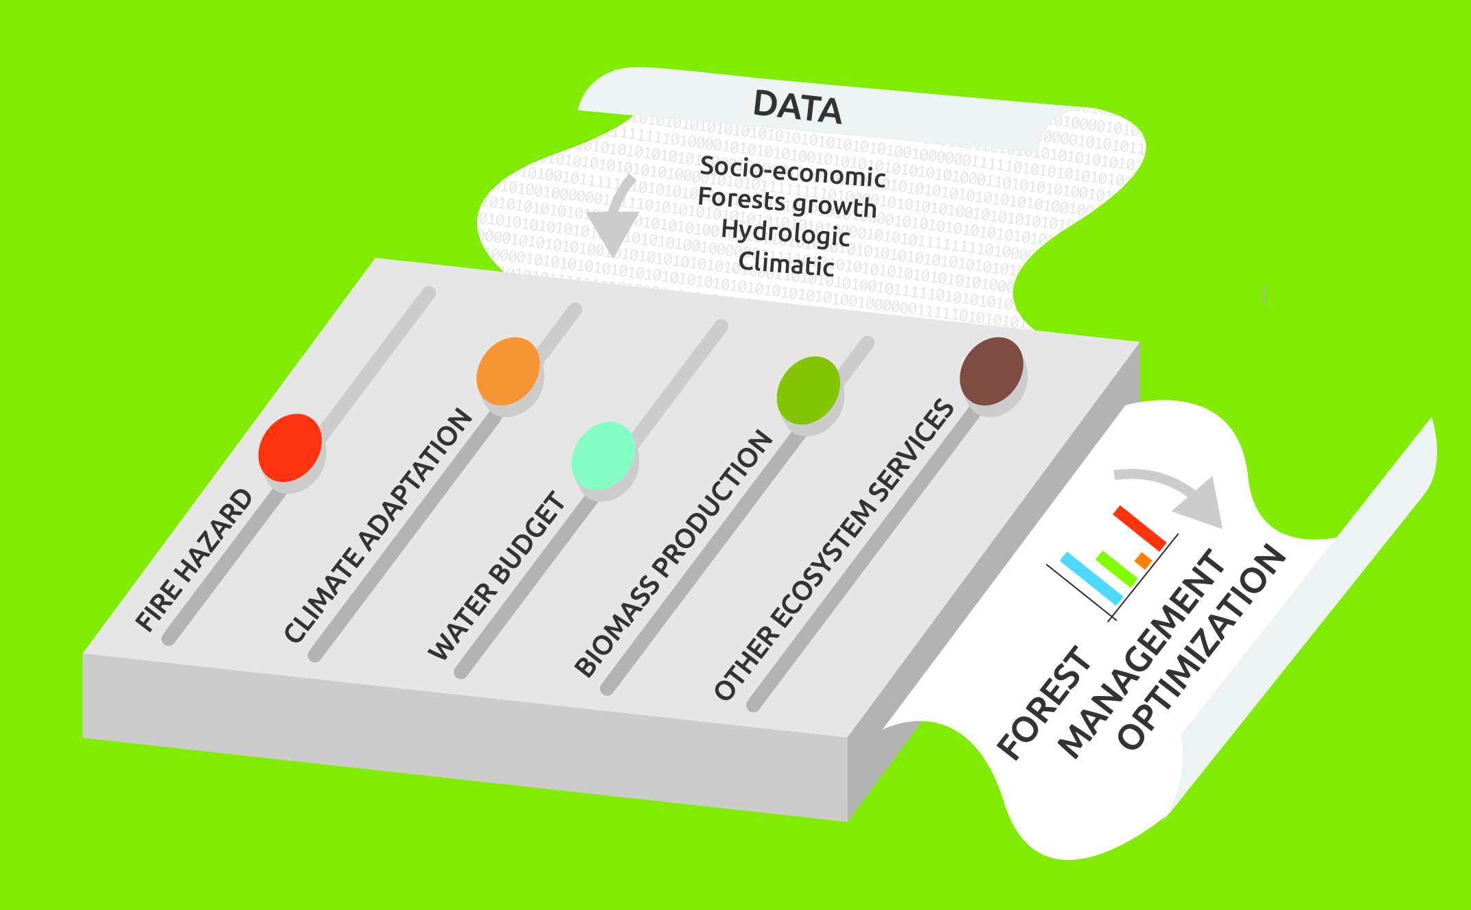









Coupling water, fire and climate resilience with biomass production in forestry to adapt watersheds to climate change
LIFE RESILIENT FORESTS is a project co-funded by the European Union’s LIFE+ Programme to promote a forest management approach at the watershed scale that improves forests resilience to wildfires, water scarcity, environmental degradation and other effects induced by climate change.
CLIMATE CHANGE AND FOREST ECOSYSTEMS
OBJECTIVES
The effects of climate change and climate variability on forest ecosystems are evident around the world and impacts are unavoidable, at least in the short and medium term. Climate change affects forest ecosystems negatively by making forests less resilient to disturbances, such as the reduction of plant growth, the frequency and the intensity of pest and disease outbreaks, wildfires and wind storms.
• To develop a Decision Support System (DSS) for forest managers
• To demonstrate the DSS at sub-catchment and catchment scale, in Germany, Portugal and Spain.
• To develop a complete monitoring system, including a Life Cycle Assessment of the sustainable forest management approach
• To transfer the knowledge and to replicate sustainable forest management approaches across
RESILIENT FORESTS DSS TOOL
DECISIÓN
The DDS system aims to:
• guide forest managers in the climate change adaptations
• optimize and update forest managements at the watershed scale incorporating climate change issues
• combine the main forest goods and forest services into a multi-stakeholder multi-criteria tool based on the different environmental and socioeconomic situations
• couple the different results of hydrological, biomass, hydroeconomic and climate change models in order to set optimal management practices
ACTIVITIES
Decision Support System – DSS
LIFE Resilient Forest will develop a system to introduce climate change adaptation strategies in forest management across Europe. This tool will be based on a successful approach already adopted by the municipality of Serra (Valencia, Spain).
Demonstration
The support system will be adapted to different conditions and demonstrated at three locations in Germany, Portugal and Spain, both at sub-catchment and at catchment scale..
Replication
A replication strategy will be developed for transferring this approach, so it can be applied elsewhere across Europe.
Monitoring
The project will conduct a complete monitoring of the impacts, including a Life Cycle Assessment (LCA) of the system, to prove the environmental soundness of the approach and its socioeconomic effects in rural areas.
EXPECTED RESULTS
Networking
Networking activities will be developed so the project can take advantage of other successful initiatives related to forest management and climate change, and to facilitate the transfer of information on forest management and climate change initiatives.
• Replication of the sustainable forest management scheme up to 350,000 ha in Europe
• Increased water reserve 45-200 l/m²/y
• Increased biomass production up to 10-15 t/ha/y
• Reduced fire hazard - 30%
• Enhanced forest resilience to environmental disturbances +25%
www.resilientforests.eu
Project Partners
El proyecto “LIFE RESILIENT FORESTS – Coupling water, fire and climate resilience with biomass production from forestry to adapt watersheds to climate change” está cofinanciado por el Programa LIFE de la Unión Europea de referencia LIFE 17 CCA/ ES/000063.

