Slide 1



ECO-HYDROLOGICAL MODELLING AT CATCHMENT SCALE
May 27
Webinar
Prepared by: Prof. Félix Francés
The project LIFE RESILIENT FORESTS – Coupling water, fire and climate resilience with biomass production from forestry to adapt watersheds to climate change is co-funded by the LIFE Programme of the European Union under contract number LIFE 17 CCA/ES/000063.

Slide 2

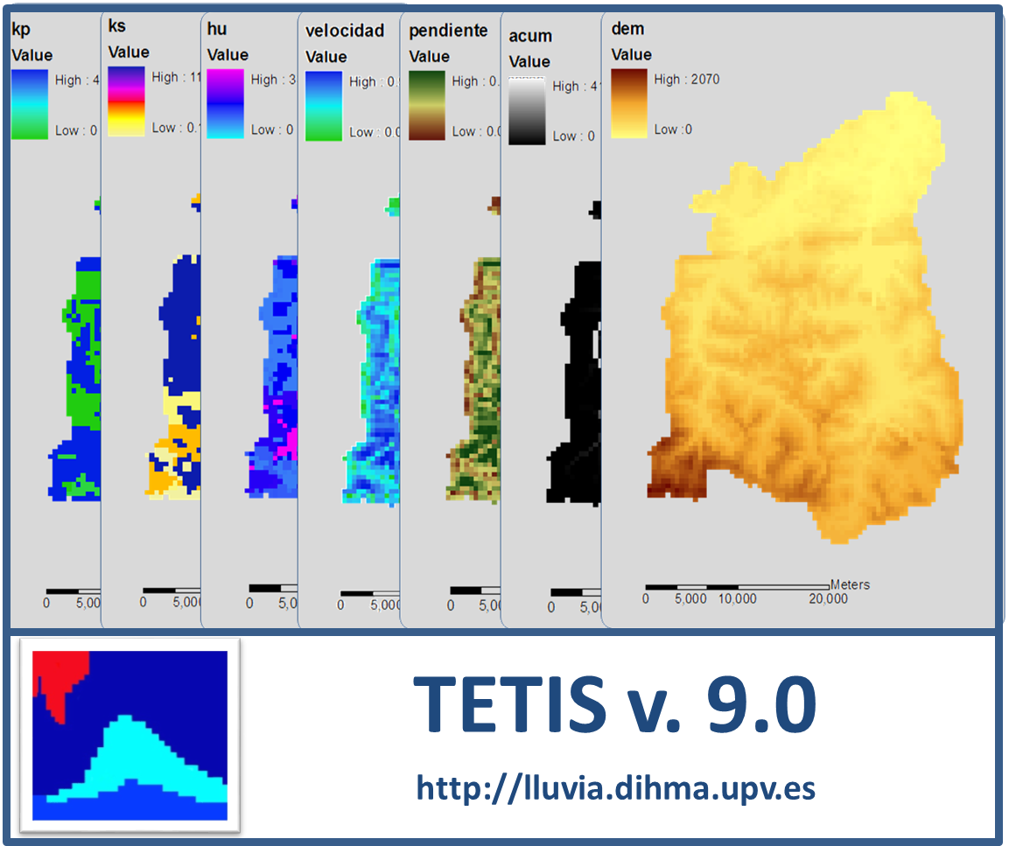
Why an eco-hydrological model?
To produce basic information (vegetation and water) for other models (biomass production, fire risk, climate resilience) and the DSS with different:
  Forest management alternatives
  Climate scenarios
It is needed to reproduce the interactions between forest management and water cycle at catchment scale pixel by pixel

Slide 3
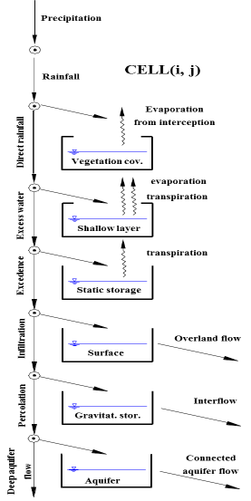
TETIS eco-hydrological model
Developed by our group since 1994 (version 9 on the web: http://lluvia.dihma.upv.es)
Conceptual (tank structure) model, with physically based parameters
Parsimonious: 9 parameters for hydrologic sub-model
Integral model: water resources, floods, sediments, dynamic vegetation, crop production, N-C cycle, … and more to come!

Slide 4
TETIS eco-hydrological model
Dynamic vegetation sub-model
  State variable: leaf biomass
  Based on the Light Use Efficiency (LUE)
  Connection with the water cycle:
  11 parameters (not all equally influent)

Slide 5
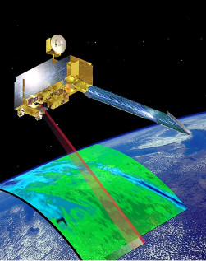
TETIS eco-hydrological model
Distributed in space:
  Reproduces the spatial variability of the hydrological cycle
    And the spatial variability of forest management
  Exploit all available spatial information
    Including remote sensing observations of state variables

Slide 6
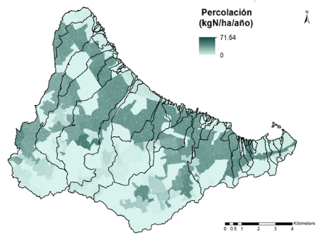
TETIS eco-hydrological model
Distributed in space:
  Reproduces the spatial variability of the hydrological cycle
    And the spatial variability of forest management
  Exploit all available spatial information
    Including remote sensing observations of state variables
  Gives results at any point

Slide 7
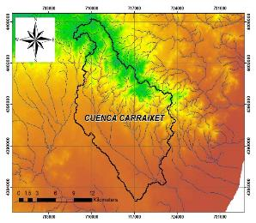
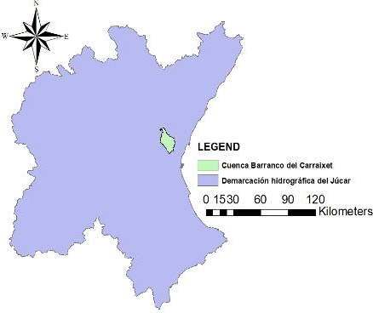
Study area: Carraixet Creek catchment
Basin area: 232 Km²
Semi-arid Mediterranean climate
  P= 400 mm/year
  ET0 = 1100 mm/year

Slide 8
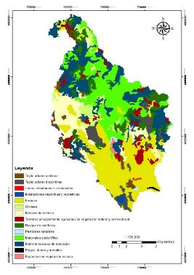
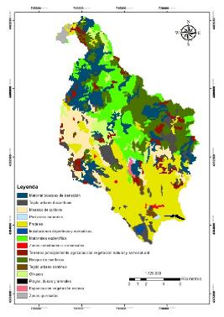
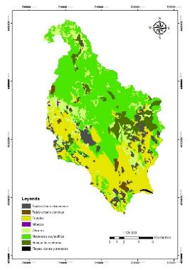
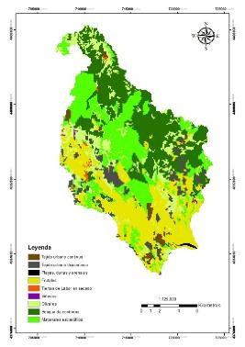
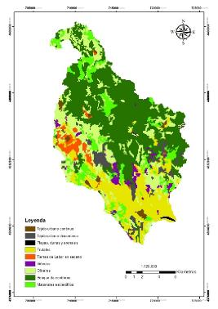
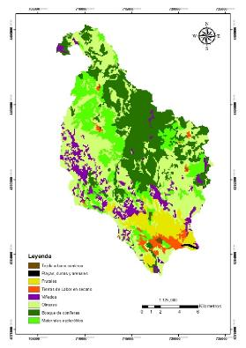
Study area: Carraixet Creek catchment
Land cover very dynamic due to fires, urbanization and crop abandonment
  45% pine forest, transition and shrub
  Natural Park
2006
2000
1991
1998
1978
1956

Slide 9
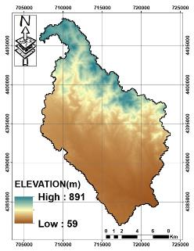
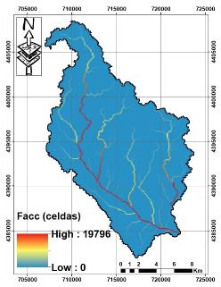
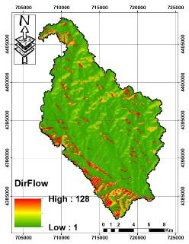
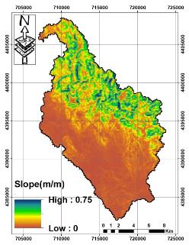
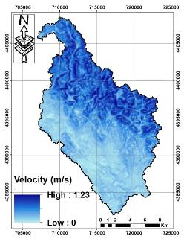
DEM derived parameters
Digital elevation model
Flow
accumulation
Flow direction
Slope
Hillslope Velocity

Slide 10
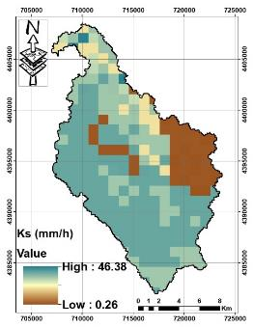
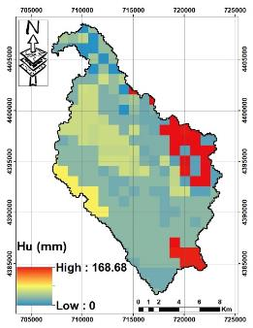
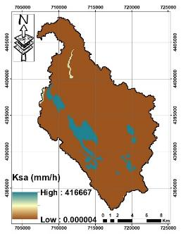
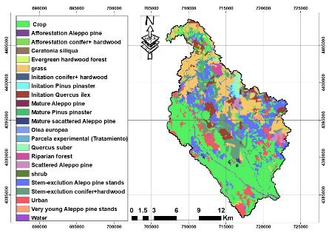
Soil, aquifer and vegetation parameters
Saturated hydraulic conductivity of the soil
Upper soil available water content (AWC)
Hydraulic conductivity of the aquifer
Vegetation classification

Slide 11
Model calibration
Δt = daily
Δx = 100 m
Main Event Characteristics
Maximum observed flow (m3/s) | 28.652
Maximum simulated flow (m3/s) | 27.080
Volume error (%) | 29.19
NSE index | 0.9105

Slide 12
Model validation
Δt = daily
Δx = 100 m
Main Event Characteristics
Maximum observed flow (m3/s) | 1.896
Maximum simulated flow (m3/s) | 0.908
Volume error (%) | -5.42
NSE index | 0.717

Slide 13

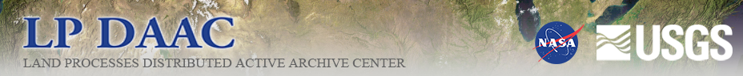
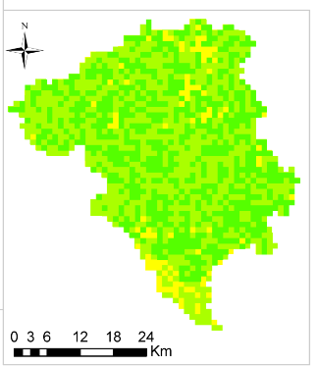
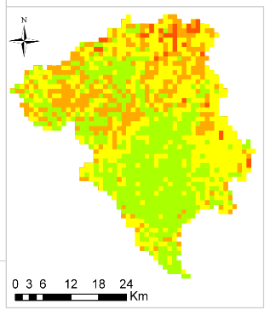
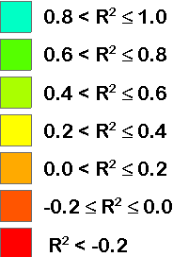
Satellite validation
Surface soil moisture
LAI

Slide 14
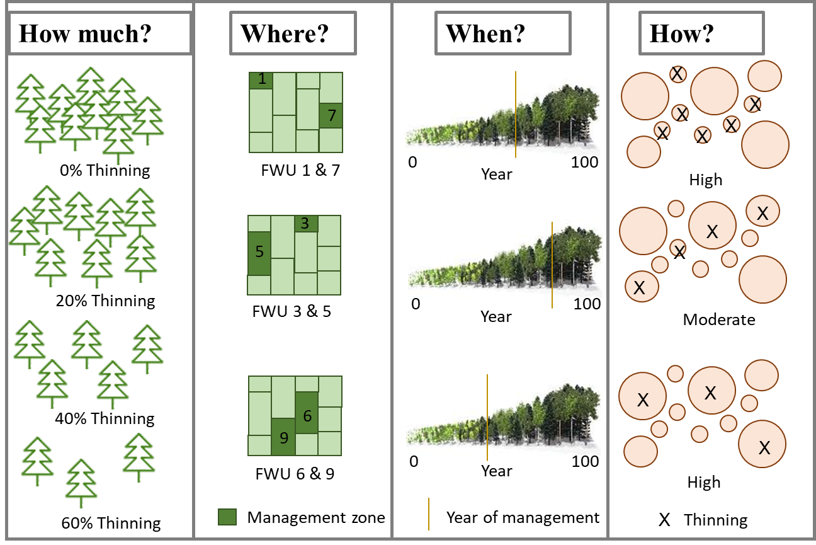
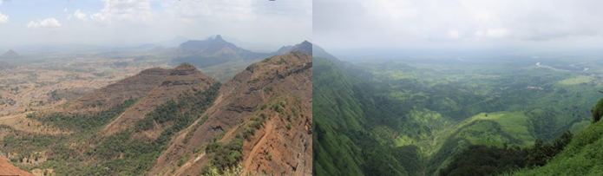
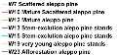
Example of model exploitation
Forest management alternatives:
W/o forest management
With forest management: Thinning half biomass every 5 years
Climatic scenarios:
Dry period 260 mm/year
Wet period 520 mm/year

Slide 15
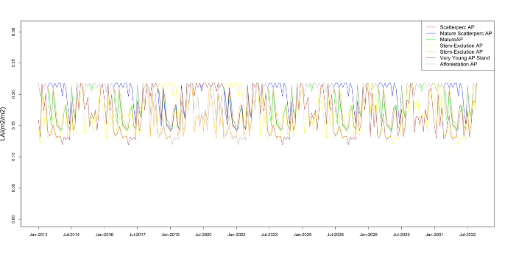
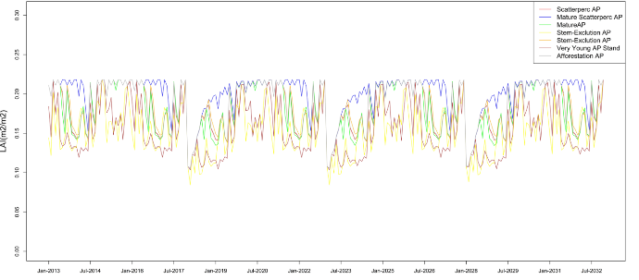
Results for LAI in dry period
W/o forest management
With forest management

Slide 16
Results for water balance
Difference in % between with and w/o forest management
  Dry period:
  Wet period:
 | W7 | W10 | W12 | W13 | W15 | W23
Overland Flow | 0,0% | 0,0% | 0,0% | 0,0% | 0,0% | 0,0%
Evapotranspiration | -5,2% | -4,9% | -5,3% | -3,0% | -5,1% | -5,2%
Percolation | 7,9% | 10,0% | 7,5% | 2,9% | 8,2% | 7,9%
 | W7 | W10 | W12 | W13 | W15 | W23
Overland Flow | 0,0% | 0,0% | 0,0% | 0,0% | 0,0% | 0,0%
Evapotranspiration | -9,1% | -9,7% | -7,6% | -5,2% | -8,9% | -9,1%
Percolation | 5,8% | 6,5% | 4,6% | 2,4% | 5,8% | 5,8%

