Slide 1





DSS / OPTIMIZATION for forest management
Prepared by: prof. Manuel Pulido-Velazquez*
Dr Hector Macian-Sorribes / prof A. Garcia-Prats
Javier Pérez Romero (PhD candidate)
* mapuve@hma.upv.es
May 27, 2020
WEBINAR
The project LIFE RESILIENT FORESTS – Coupling water, fire and climate resilience with biomass production from forestry to adapt watersheds to climate change is co-funded by the LIFE Programme of the European Union under contract number LIFE 17 CCA/ES/000063.

Slide 2


The DSS concept …
Interactive computer-based tools that assist in decision-making when addressing complex management problems, integrating:
... Simulation and optimization models
... Computer assisted graphical design
... Geographically referenced data bases
.. Graphical tools for results display and analysis
Characteristics:
User-friendly, flexibility, learning, interaction, fast response

Slide 3
ROLE of DSS in natural resource management problems
Many examples in the literature
BUT:
“Although this idea (DSS) was a promising one, previously few of these systems have come to fruition and are actually used on a regular basis” (Rietma et al., 1996)

Slide 4
DSS AQUATOOL for water resources management
(Andreu et al., 1996)

Slide 5
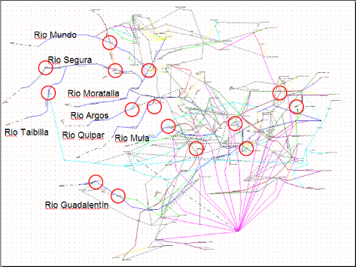
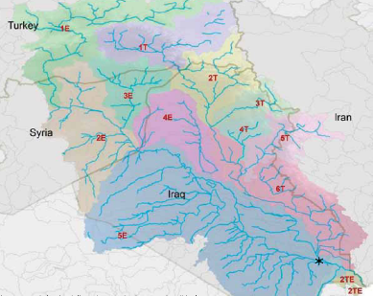
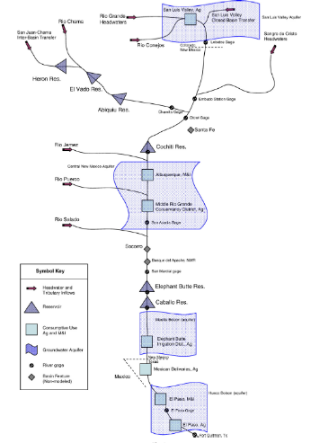
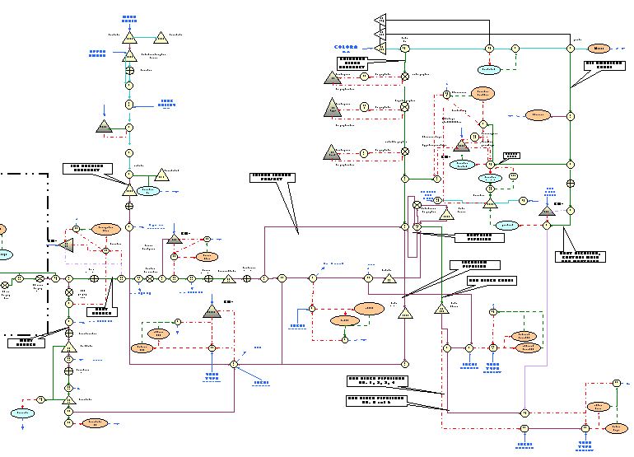
Experience in development of DSS for WRPM
Segura basin
Spain
Tigris-Euphrates, Asia
Rio Grande
USA
California, USA

Slide 6
DSS for Forest Management
SMART CHOICES in decision- making problems
8 elements of smart choices (PROACT):
Problem
Objectives
Alternatives
Consequences
Tradeoffs
Uncertainy
Risk Tolerance
Linked decisions
J Hammond, R Keeny, H Raiffa. Smart choices. 2005

Slide 7
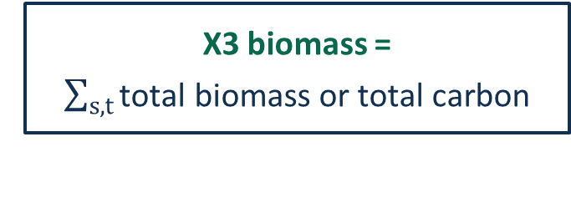

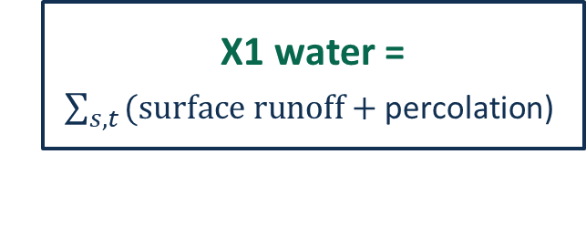
DSS for Forest Management
2. OBJECTIVES
Basis for evaluating your alternatives - decision criteria
> MULTIOBJECTIVE PROBLEM
OBJECTIVES – (aggregated) metrics:
X1 water = $\sum_{s,t}{\text{(}\text{surface} \text{runoff}\text{ + }\text{percolation}\text{)} }$
Max WATER YIELD
Min FIRE RISK
Max BIOMASS production
Max RESILIENCE
… Min COST
X2 fire risk = $average Rate Of Spread$
Fire Weather Index
X3 biomass = $\sum_{s,t}{\text{total} \text{biomass} \text{or} \text{total} \text{carbon}}$

Slide 8
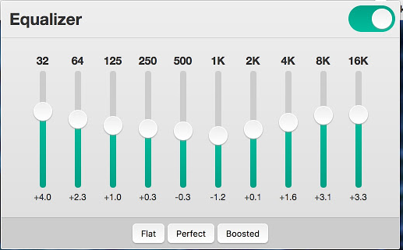
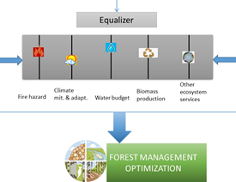
DSS for Forest Management
EQUALIZER approach
Notes:
You can

Slide 9
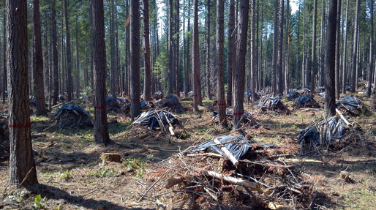
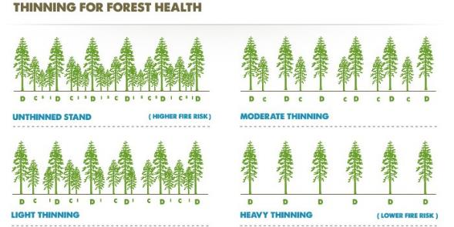
DSS for Forest Management
“You can’t never choose an alternative you have not considered"
3. ALTERNATIVES
(decision space)
Spatial allocation, timing & intensity of
thinning

Slide 10
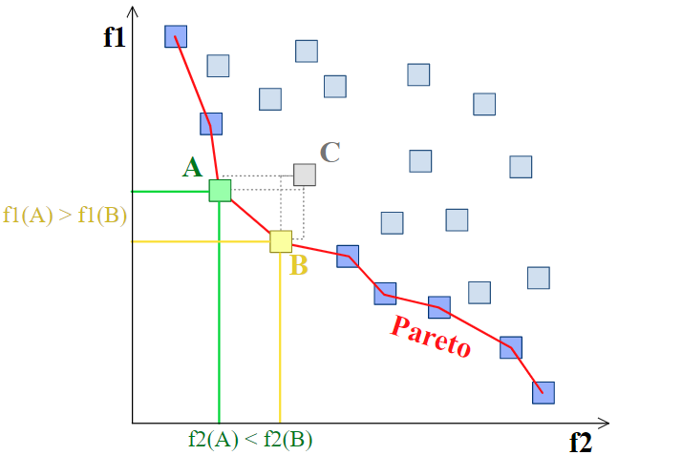
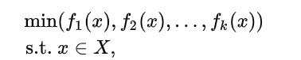
DSS for Forest Management
5. EVALUATE TRADEOFFS
Many times, objectives will conflict with each other -> evaluate tradeoffs between the objectives
evolutionary algorithms -> set of Pareto optimal solutions
X: fesible ser of decision vectors (typically defined by some constraint functions)
Example: less is better
C, dominated strategy
A & B, dominant strategies
(PARETO FRONT, set of optimal non-dominated solutions)

Slide 11
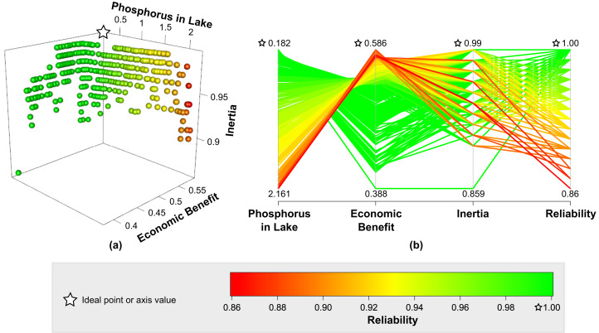
DSS for Forest Management
Posteriori DSS: DMs are presented with an explicit representation of the tradeoffs for them to express preference for 1 or more solutions
"The purpose of computing is insight, not numbers", Richard W. Hamming

Slide 12

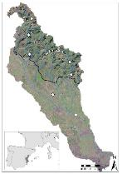
Decision Support System
Simulation TOOLBOX
Management options
WRM model
Water cycle
Water resources
n alternatives
Ecosystem services
Economic values
OPT toolbox
Biomass
Wood
CO2 seq
n responses
Forest
resilience
Dominant alternatives
Fire control
Pareto front
Weights elicitation / participation
Max ec value
Decision

Slide 13
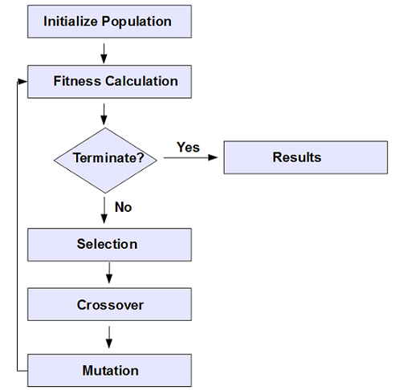
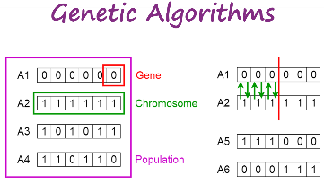
Multiobjective genetic algorithm (MOEA) open source code http://borgmoea.org/
Pennsylvania State University
BORG algorithm
GA: biologicaly inspired stochastic metaheuristic for combinatorial
search & optimization
“Fancy” methods of trial & error
Data-based
modelling method
Evolutionary Algorithms

Slide 14
DSS: OPTIMIZATION for forest management
Prepared by: prof. Manuel Pulido-Velazquez*
Dr Hector Macian-Sorribes / prof A. Garcia-Prats / Javier Pérez Romero (PhD candidate)
* mapuve@hma.upv.es
May 27, 2020
WEBINAR
The project LIFE RESILIENT FORESTS – Coupling water, fire and climate resilience with biomass production from forestry to adapt watersheds to climate change is co-funded by the LIFE Programme of the European Union under contract number LIFE 17 CCA/ES/000063.

