Slide 1
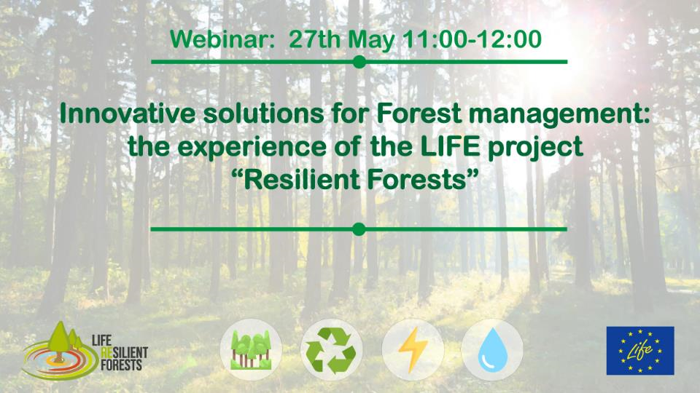
CONTENTS:
1.- Introduction: Project description
2.- Forest management: C.A.F.E. concept
3.- LIFE Resilient Forests DSS Tool:
3.1.- General description
3.1.1.- What is it?
3.1.2.- What can I use it for?
3.1.3.- What do I need to use it?
3.2.- Eco-hydrological model: TETIS
3.3.- Optimization
4.- Practical example
5.- Questions

Slide 2




Coupling water, fire and climate resilience with biomass production from forestry to adapt watersheds to climate change
Prepared by: María González Sanchis
macgonsa@gmail.com
Webminar
27° May 2020
The project LIFE RESILIENT FORESTS – Coupling water, fire and climate resilience with biomass production from forestry to adapt watersheds to climate change is co-funded by the LIFE Programme of the European Union under contract number LIFE 17 CCA/ES/000063.

Slide 3


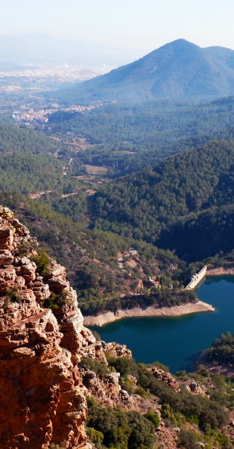
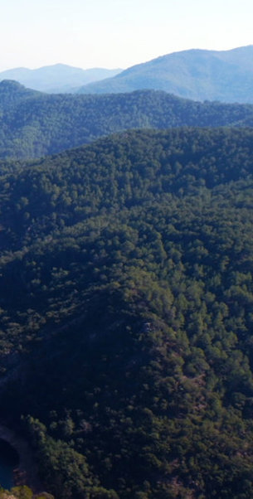
www.resilientforest.eu
RESILIENT FORESTS PROJECT
Co-funded project by the European Union’s LIFE+ Programme to promote a forest management approach at the watershed scale that improves forests resilience to wildfires, water scarcity, environmental degradation and other effects induced by climate change.

Slide 4







The project LIFE RESILIENT FORESTS is co-funded by the LIFE Programme of the European Union under contract number LIFE 17 CCA/ES/000063.
PARTNERS
FORSCHUNGSZENTRUM JÜLICH GMBH Germany
ASSOCIAÇÃO PARA O DESENVOLVIMENTO DA AERODINÂMICA INDUSTRIAL
Portugal
RESEARCH INSTITUTE OF WATER AND ENVIRONMENTAL ENGINEERING Technical University of Valencia, Spain
EUROPEAN BIOMASS INDUSTRY ASSOCIATION Belgium
AYUNTAMIENTO DE SERRA Spain

Slide 5


www.resilientforest.eu
OBJECTIVES
  Developing a Decision Support System (DSS) for forest managers;
  Demonstrating the DSS tool at both catchment and sub-catchemnt level in Germany, Portugal and Spain.
  Developing a complete monitoring system, including a Life Cycle Assessment of the forest management approach, that will demonstrate the positive environmental impact of the project, as well as its socioeconomic impact;
  Transferring management approaches around Europe.

Slide 6
www.resilientforest.eu
OBJECTIVES

Slide 7

EXPECTED RESULTS
  Demonstration and replication of a successful, innovative forest management scheme at a watershed scale, which will be further expanded up to 350,000 hectares;
  Increased water reserves of 45-200 l/m²/year and increased water availability downstream, leading to a reduction in energy extraction costs to 5 W/hm;
  Increased sustainable biomass production for between 10 and 15 t/ha year;
  Reduced fire hazards by 30%;
  Increased resilience of 25% of forest areas to withstand droughts, pests and disease outbreak.

Slide 8
CONTENTS:
1.- Introduction: Project description
2.- Forest management: C.A.F.E. concept
3.- LIFE Resilient Forests DSS Tool:
3.1.- General description
3.1.1.- What is it?
3.1.2.- What can I use it for?
3.1.3.- What do I need to use it?
3.2.- Eco-hydrological model: TETIS
3.3.- Optimization
4.- Practical example
5.- Questions

Slide 9
CONTENTS:
1.- Introduction: Project description
2.- Forest management: C.A.F.E. concept
3.- LIFE Resilient Forests DSS Tool:
3.1.- General description
3.1.1.- What is it?
3.1.2.- What can I use it for?
3.1.3.- What do I need to use it?
3.2.- Eco-hydrological model: TETIS
3.3.- Optimization
4.- Practical example
5.- Questions

Slide 10

DSS TOOL, WHAT IS IT?
Forest management tool that brings together:
Adaptive forest management approach
Decision Support System

Slide 11
DSS TOOL, WHAT IS IT?
The DSS concept:
Interactive computer-based tools that assist in decision-making when addressing complex management problems, integrating:
Computer assisted graphical design
Geographically referenced data bases
Graphical tools for results display and analysis
Characteristics:
User-friendly, flexibility, learning, interaction, fast response

Slide 12
WHAT CAN I USE IT FOR?
Multicriteria forest management:
Biomass (production)
Water
Fire risk
Climate resilience
Others

Slide 13

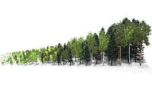
WHAT CAN I USE IT FOR?
Multi-decision and multi-criteria forest management:
How much?
Where?
When?
How?
1
X
7
X
X
X
X
X
0% Thinning
FWU 1 & 7
0
Year
100
High
3
X
X
5
X
20% Thinning
X
FWU 3 & 5
0
Year
100
Moderate
X
X
40% Thinning
6
9
X
FWU 6 & 9
0
Year
100
High
60% Thinning
Management zone
Year of management
X
Thinning

Slide 14
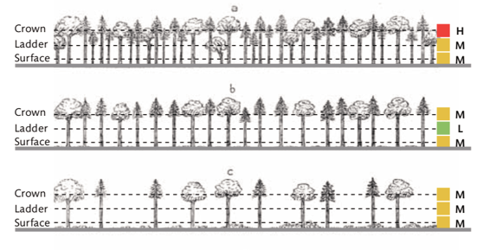
WHAT CAN I USE IT FOR?
Many-criteria forest management:
How much?
% Forest Cover
Kg/m² o biomass/ha
B.A.; density,…
Ref: Forestry Commission (2014). Building wildfire resilience into forest management planning

Slide 15
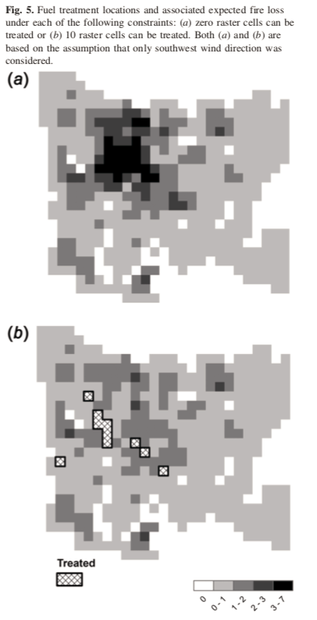
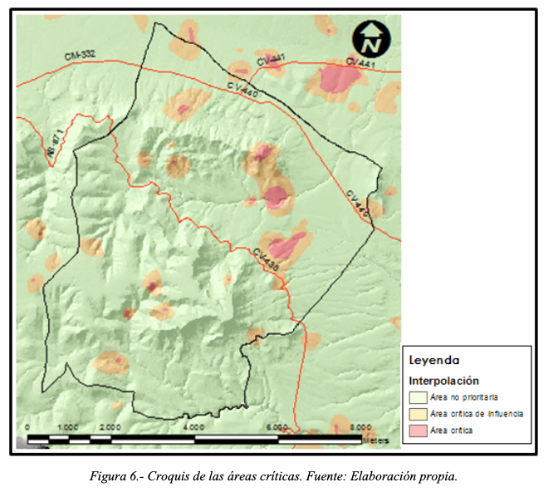
WHAT CAN I USE IT FOR?
Many-criteria forest management:
Where?
Spatial optimization, with and without area and or slope restrictions.
It combines the different management objectives.
Ref: Calabuig, Molina y Escrig, 2014
Ref: Wei, Y., Rideout, D., & Kirsch, A. (2008). An optimization model for locating fuel treatments across a landscape to reduce expected fire losses. Canadian Journal of Forest Research, 38(4), 868–877.doi:10.1139/x07-162

Slide 16
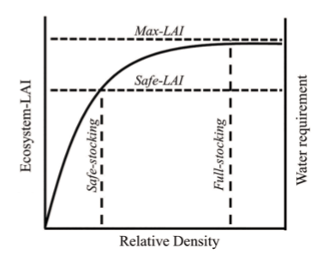
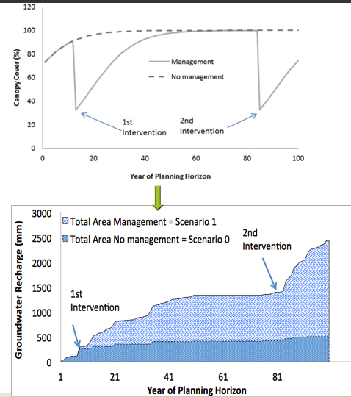
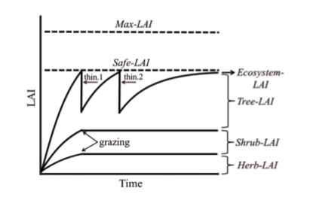
WHAT CAN I USE IT FOR?
Many-criteria forest management:
When?(Rotation)
Ref: Yagil Osem and K. O’Hara 2016 An ecohydrological approach to managing dryland forests: integration of leaf area metrics into assessment and management Forestry, 89, 338–349, doi:10.1093/forestry/cpw021

Slide 17
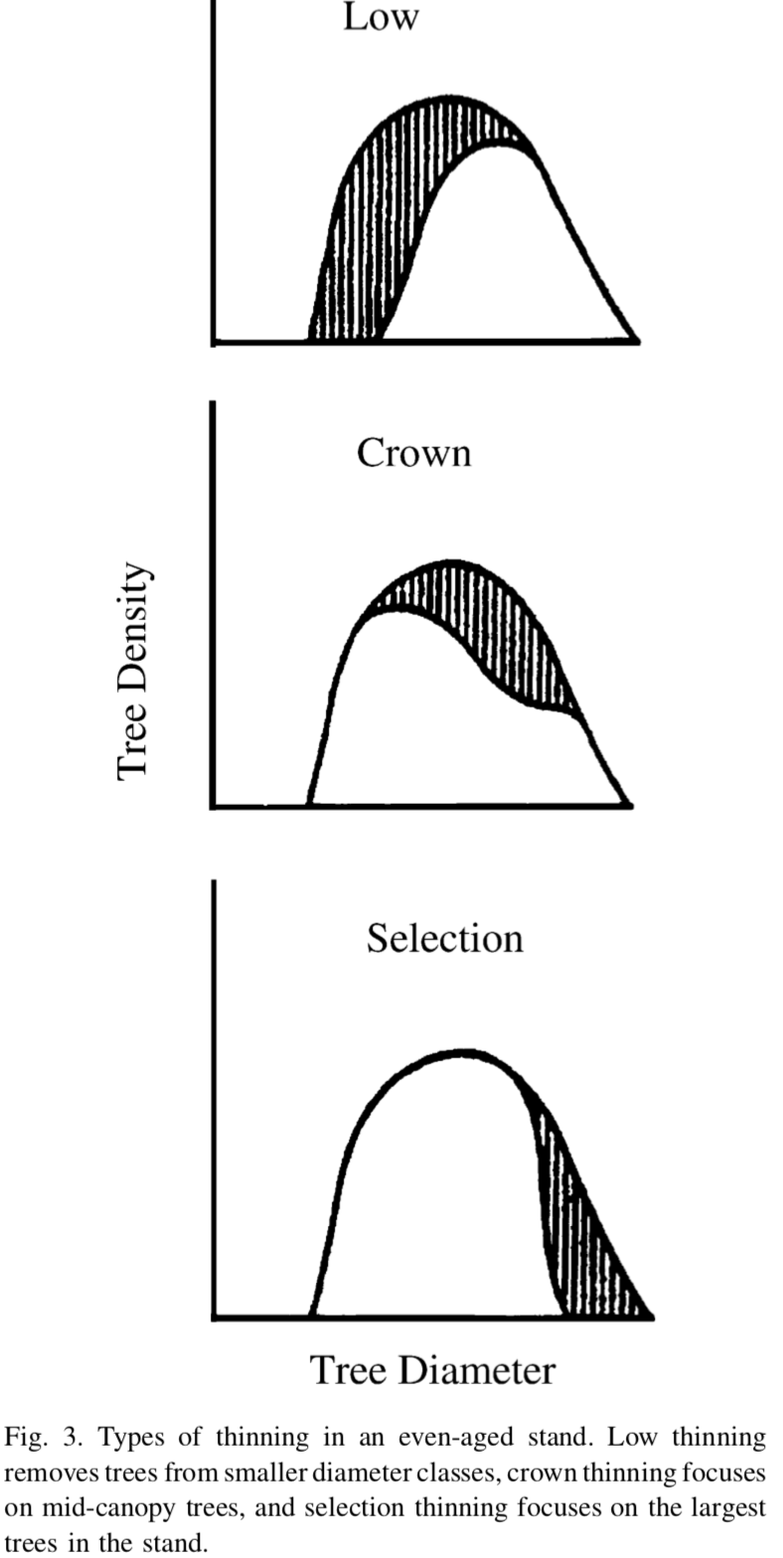
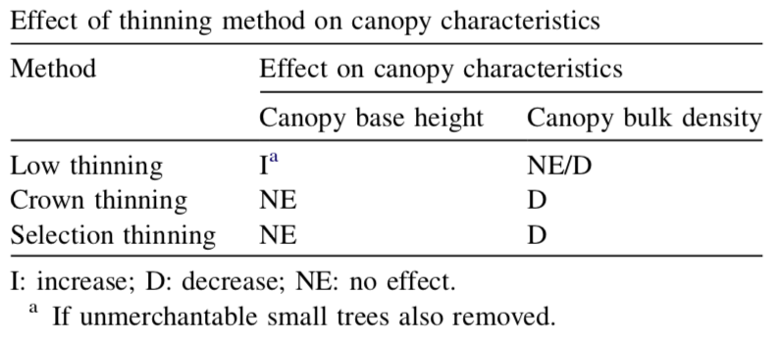
WHAT CAN I USE IT FOR?
Many-criteria forest management:
How
Thinning.
Regeneration/Improvement treatments.
Spatial thinning distribution.
Species and stratum.
Ref: Agee et al., 2005. doi:10.1016/j.foreco.2005.01.034

Slide 18
HOW DOES IT WORK?
Spatial scale: from stand to catchment.
Objectives: up to 4 among: water production, biomass production, CO₂, fire risk, climatic resilience and biodiversity.
The user establishes the relevance of each objective.
Decision variables: what, how, when and/or where.
Combines optimization algorithms with eco-hydrological simulation, such as:
  TETIS (UPV-Spain)
  RHESSYS (UCSB, USA)
RESULTS: list of possible solutions.

Slide 19
WHAT DO I NEED?
Inputs for the eco-hydrological simulation:
  DTM
  Vegetation: species and forest cover maps
  Sol characteristics
  Climate data
0

Slide 20
WHAT DO I NEED?
Outline of management possibilities and objectives accordingly (site, species, structure, age, density and vulnerability).
Model inputs
Eco-hydrological model
RESULTS
Management options
+
Objectives
+
Optimization algorithm

Slide 21
CONTENTS:
1.- Introduction: Project description
2.- Forest management: C.A.F.E. concept
3.- LIFE Resilient Forests DSS Tool:
3.1.- General description
3.1.1.- What is it?
3.1.2.- What can I use it for?
3.1.3.- What do I need to use it?
3.2.- Eco-hydrological model: TETIS
3.3.- Optimization
4.- Practical example
5.- Questions

